Slide 1
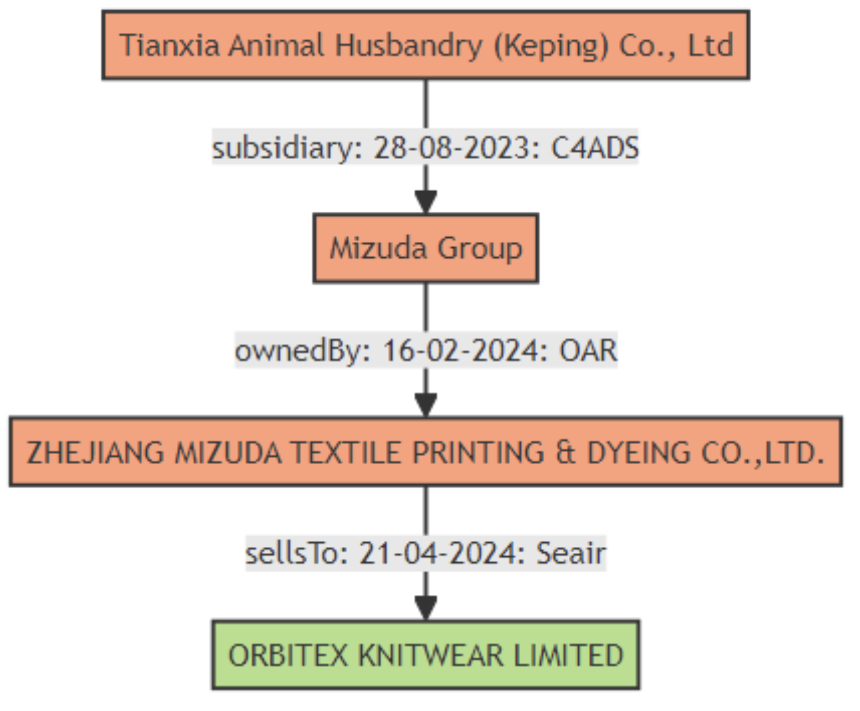
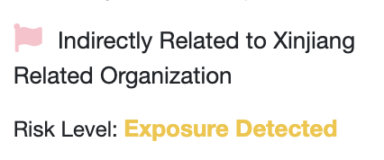
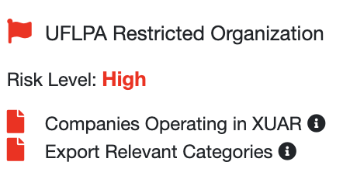
ORBITEX KNITWEAR LIMITED
(Direct Supplier)
Buys from: Date as at: 21-4-2024 Source: Commercial Trade Data
Zhejiang etc.
Subsidiary of : Date as at: 16-02-2024 Source: Open Data / Public Registry
Mizuda Group
Owned by: Date as at: 28-02-2023 Source: Open Data / Public Registry
Tianxia etc.

